Slide 1
Cardiovascular Diseases: Arrhythmia
Here is where your presentation begins

Slide 2
Contents of this template
This is a slide structure based on a disease presentation
You can delete this slide when you’re done editing the presentation
Fonts | To view this template correctly in PowerPoint, download and install the fonts we used
Used and alternative resources | An assortment of graphic resources that are suitable for use in this presentation
Thanks slide | You must keep it so that proper credits for our design are given
Colors | All the colors used in this presentation
Icons and infographic resources | These can be used in the template, and their size and color can be edited
Editable presentation theme | You can edit the master slides easily. For more info, click here
For more info:
SLIDESGO | SLIDESGO SCHOOL | FAQS
You can visit our sister projects:
FREEPIK | FLATICON | STORYSET | WEPIK | VIDFY

Slide 3
Table of contents
01
02
03
The disease
Diagnosis
Recommendations
04
05
06
Pathology
Treatment
Conclusions
You can describe the topic of the section here
You can describe the topic of the section here
You can describe the topic of the section here
You can describe the topic of the section here
You can describe the topic of the section here
You can describe the topic of the section here

Slide 4
Introduction
You can give a brief description of the topic you want to talk about here. For example, if you want to talk about Mercury, you can say that it’s the smallest planet in the entire Solar System

Slide 5
01
The disease
You can describe the topic of the section here

Slide 6
Range of the disease
Simple discomfort
Fatal problem
Venus has a beautiful name and is the second planet from the Sun
Mercury is the closest planet to the Sun and the smallest of them all

Slide 7
Types of arrhythmias
Ventricular fibrillation
Ventricular tachycardia
Premature ventricular beats
Torsades de pointes
Mercury is the smallest planet in the galaxy
Mars is actually a very cold place
Jupiter is the biggest planet of them all
Earth is the beautiful planet where we live

Slide 8
Heart's rhythm abnormality
Too slowly
Too quickly
Irregularly
Mercury is the closest planet to the Sun and the smallest of them all
Venus has a beautiful name and is the second planet from the Sun
Despite being red, Mars is actually a cold place. It’s full of iron oxide dust

Slide 9
Pathology
Failure sinoatrial node
Irregular heartbeat
Anatomical defects
Abnormal pacemaker
01
02
Mercury is the smallest planet
Jupiter is the biggest planet of them all
03
04
Despite being red, Mars is a cold place
Saturn is a gas giant with rings

Slide 10
Symptoms of the disease
Fluttering chest
Shortness breath
Slow heartbeat
Racing heartbeat
Mercury is the smallest planet of them all
Despite being red, Mars is very cold
Jupiter is the biggest planet of them all
Saturn is the only planet with rings

Slide 11
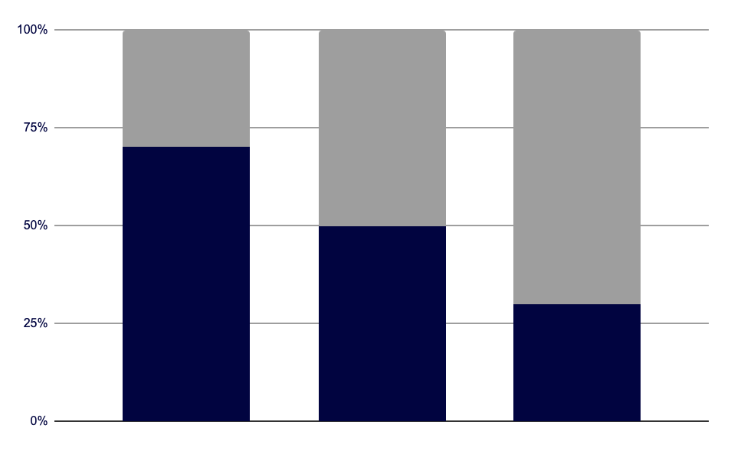
Risk factors
Causes of arrhythmia
70%
30%
People with narrowed arteries
Abnormal heart valves or others
Heart attack
Heart failure
2010
2015
2022
Follow the link in the graph to modify its data and then paste the new one here. For more info, click here
Jupiter is the biggest planet of them all
Mercury is the smallest planet of them all

Slide 12
—Someone Famous
“This is a quote. Words full of wisdom that someone important said and can make the reader get inspired.”

Slide 13
Diagnosis
Mercury
Venus
Mars
Jupiter
Saturn
Neptune
Mercury is the smallest planet of them all
Venus is the second planet from the Sun
Mars is actually a very cold place
Jupiter is the biggest planet of them all
Saturn is the only planet with rings
It’s the farthest planet from the Sun

Slide 14
Prevention
Advice 01
Advice 02
Advice 03
Advice 04
Jupiter is the biggest planet of them all
Mercury is the smallest planet
Mars is actually a very cold place
Saturn is a gas giant with rings

Slide 15
02
Diagnosis
You can describe the topic of the section here

Slide 16
Treatment
Step 1
Step 2
Step 3
Step 4
Mercury is the smallest planet
Mars is actually a very cold place
Jupiter is the biggest planet of them all
Neptune is very far from the Sun

Slide 17
Recommendations
What to do
What not to do
● Describe what the patient should do here
● Describe what the patient should do here
● Describe what the patient should do here
● Describe what the patient should not do here
● Describe what the patient should not do here
● Describe what the patient should not do here

Slide 18
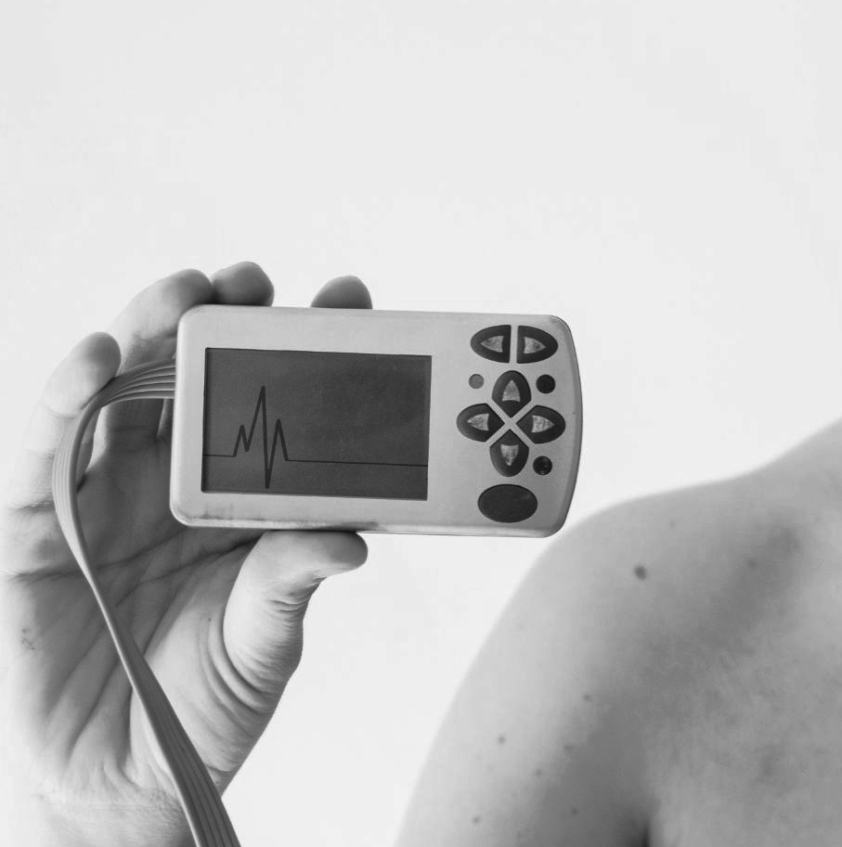
A picture always reinforces
the concept
Images reveal large amounts of data, so remember: use an image instead of long texts

Slide 19
Awesome words

Slide 20
Doctor appointments
Mercury
Venus
Mon. | Tue. | Wed. | Thu. | Fri. | Sat. | Sun.
31 | 1 | 2 | 3 | 4 | 5 | 6
7 | 8 | 9 | 10 | 11 | 12 | 13
14 | 15 | 16 | 17 | 18 | 19 | 20
21 | 22 | 23 | 24 | 25 | 26 | 27
28 | 29 | 30 | 31 | 1 | 2 | 3
Mercury is the smallest planet
Venus is the second planet from the Sun

Slide 21
Prevalence
Mercury
Jupiter
20%
Mercury is the smallest planet
80%
Jupiter is the biggest planet of them all

Slide 22
References
AUTHOR (YEAR). Title of the publication. Publisher
AUTHOR (YEAR). Title of the publication. Publisher
AUTHOR (YEAR). Title of the publication. Publisher
AUTHOR (YEAR). Title of the publication. Publisher
AUTHOR (YEAR). Title of the publication. Publisher
AUTHOR (YEAR). Title of the publication. Publisher
AUTHOR (YEAR). Title of the publication. Publisher
AUTHOR (YEAR). Title of the publication. Publisher

Slide 23
Website
You can replace the image on the screen with your own work. Just right-click on it and select “Replace image”

Slide 24
Conclusions
Do you know what helps you make your point clear?
Lists like this one:
They’re simple
You can organize your ideas clearly
You’ll never forget to buy milk!
And the most important thing: the audience won’t miss the point of your presentation

Slide 25
Thanks!
Do you have any questions? youremail@freepik.com
+91 620 421 838 yourcompany.com
Please keep this slide for attribution

